Slide 1
Logan Buck
Chemical Engineering
Class of 2016
Recipient of,
Choose Ohio First Scholarship Program
Teacher:
Ashley Gregory
Class:
7th Grade Science
RET is funded by the National Science Foundation, grant # EEC-1404766
Endothermic & Exothermic Reactions
RET is funded by the National Science Foundation, grant # EEC-1404766
Pic of Ashley, Logan, & The Class
The Chemistry of
Hot and Cold

Slide 2
Unit Overview
Topic:
Thermal Energy Transfer through Chemical Reactions
Standards:
07-PS1-2. Analyze and interpret data on the properties of substances before and after the substances interact to determine if a chemical reaction has occurred.
07-PS1-6. Undertake a design project to construct test and modify a device that either releases or absorbs thermal energy by chemical processes.

Slide 3
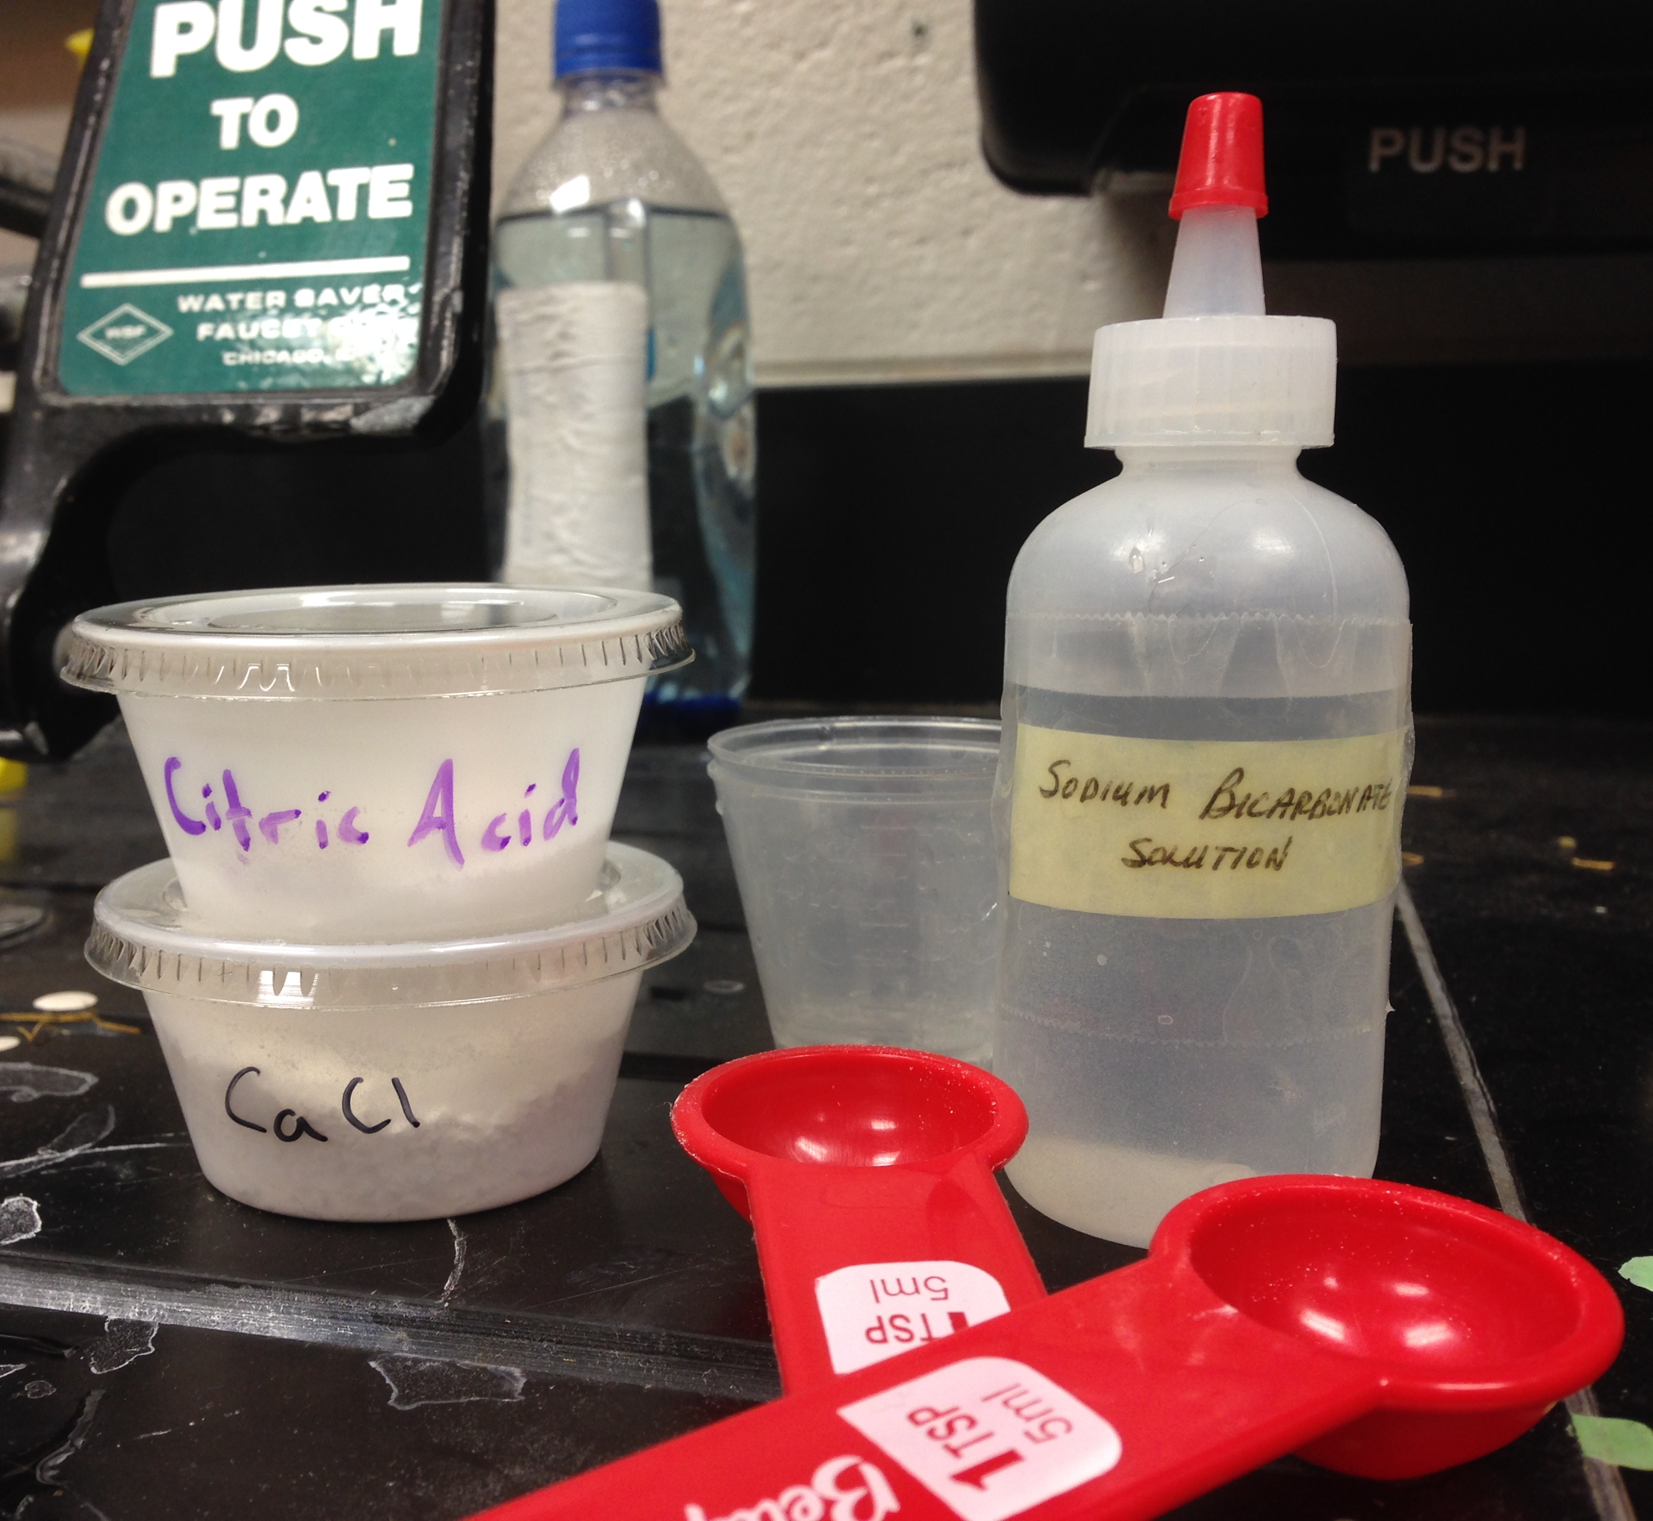
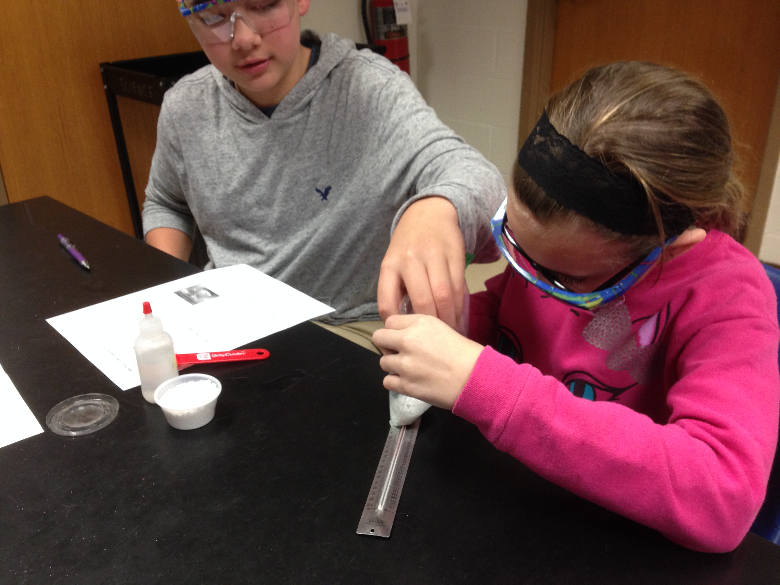
Activity Highlights
Title:
Application of Endothermic & Exothermic Reactions
Guiding Questions:
What is an endothermic reaction? What is an exothermic reaction?
What are the characteristics of an endothermic reaction? Of an exothermic reaction?
What are some examples of chemical change? What are some examples of physical change?
What is the effect of concentration on the transfer of energy?
Are there other ways to improve the transfer of energy?
Objectives:
Define what endothermic and exothermic reactions are
Identify endothermic and exothermic reactions
Identify chemical vs. physical change
Recognize the effect of concentration on the transfer of energy

Slide 4
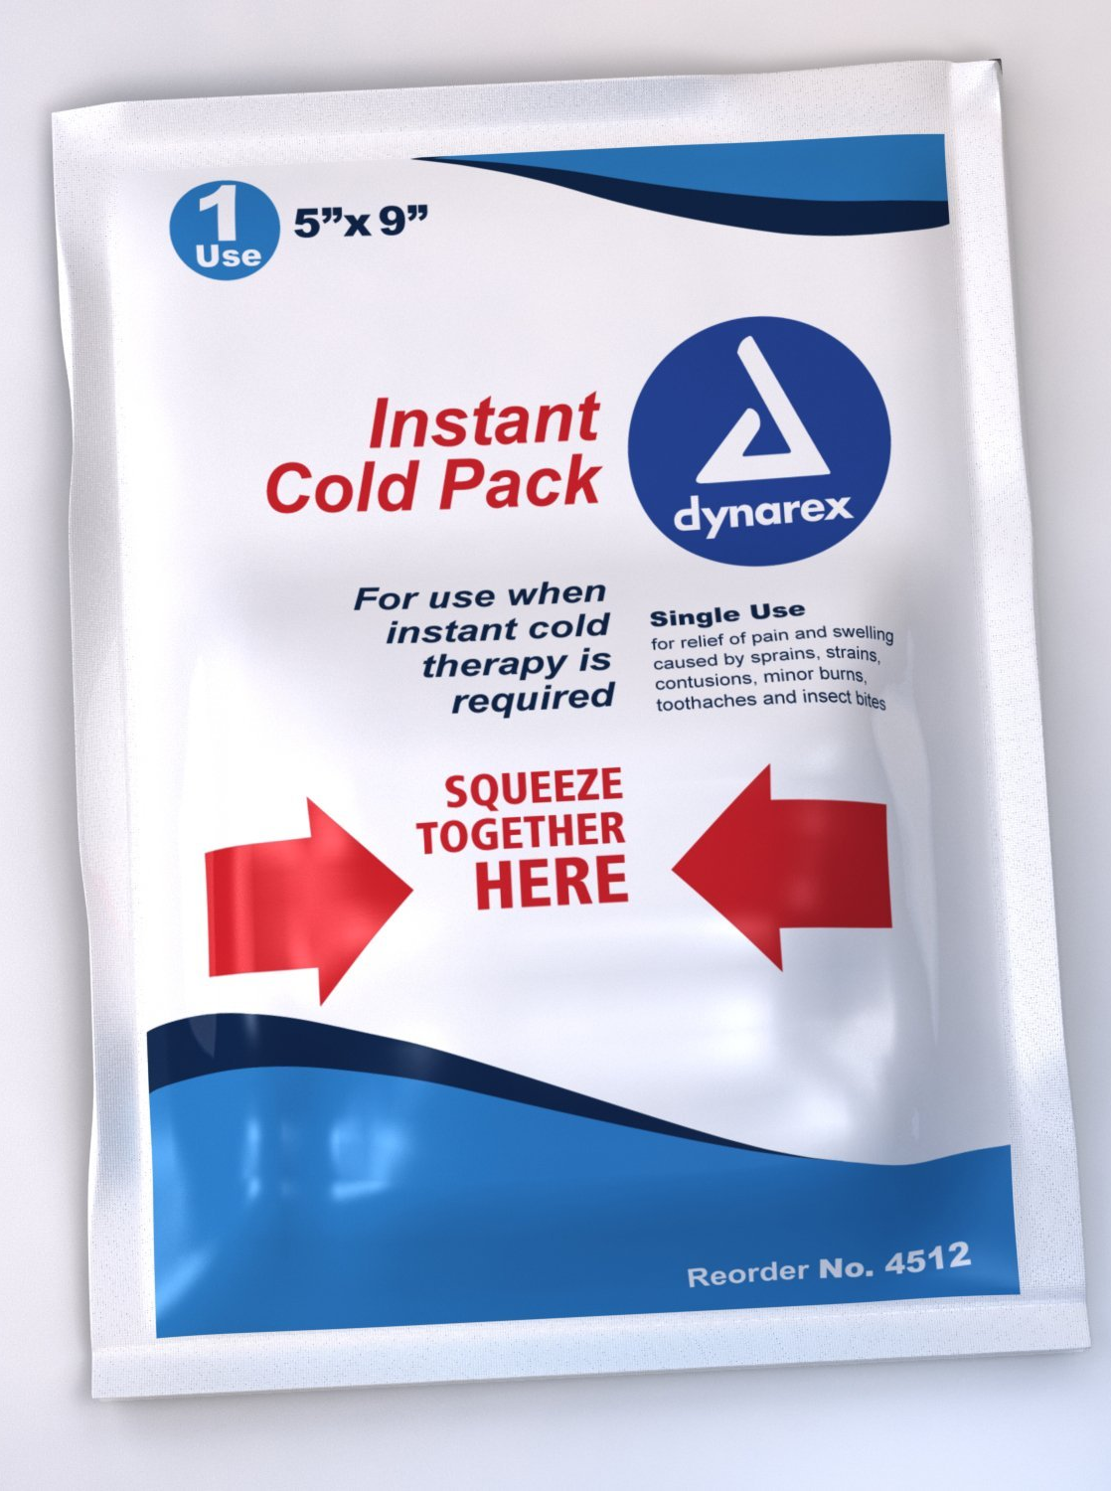
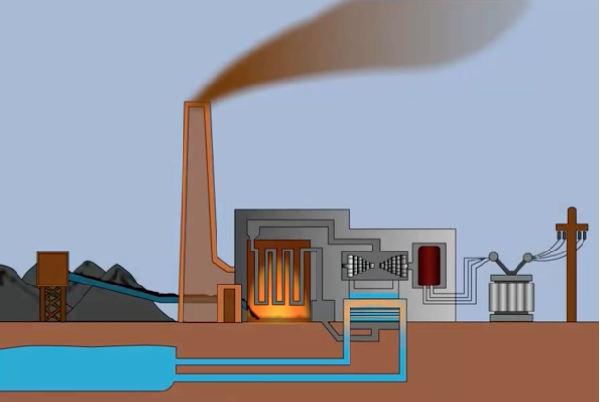
ACS in Activity
Applications in the real world
Discussed Endothermic and Exothermic reactions used for instant cold and hot packs
Career awareness
Chemical Engineers need to be aware of thermal energy transfer within reactions for all manufacturing and lab scale processes
Societal impact
Demonstrated thermal energy transfer through reactions and phase changes in a coal fired power plant

Slide 5
Evidence of Student Learning
The results show an average increase in class average of 27% from a 47% to a 65%
Students showed a much better understanding of endothermic and exothermic reactions, but were confused by questions that had options such as ‘(d) Both a & c’
The grades across the board were low due to personal inexperience in assessment question writing.
Class | 1 | 2 | 5 | 6 | 7 | Overall
Pre-Test | 52% | 42% | 54% | 49% | 41% | 47%
Post-Test | 64% | 65% | 67% | 70% | 59% | 65%
Percent Change | 19% | 35% | 19% | 30% | 30% | 27%
The results show an average increase in class average of 27%
However, the grades across the board were low due to personal inexperience in assessment question writing.
Students showed a much better understanding of endothermic and exothermic reactions, but were confused by questions that had options such as ‘(d) Both a & c’
The results show an average increase in class average of 27%
However, the grades across the board were low due to personal inexperience in assessment question writing.
Students showed a much better understanding of endothermic and exothermic reactions, but were confused by questions that had options such as ‘(d) Both a & c’
The results show an average increase in class average of 27%
However, the grades across the board were low due to personal inexperience in assessment question writing.
Students showed a much better understanding of endothermic and exothermic reactions, but were confused by questions that had options such as ‘(d) Both a & c’
Class | 1 | 2 | 5 | 6 | 7 | Overall
Pre-Test | 52% | 42% | 54% | 49% | 41% | 47%
Post-Test | 64% | 65% | 67% | 70% | 59% | 65%
Percent Change | 19% | 35% | 19% | 30% | 30% | 27%
Class | 1 | 2 | 5 | 6 | 7 | Overall
Pre-Test | 52% | 42% | 54% | 49% | 41% | 47%
Post-Test | 64% | 65% | 67% | 70% | 59% | 65%
Percent Change | 19% | 35% | 19% | 30% | 30% | 27%

Slide 6
Engineering Design Process
Students had to perform the reaction with a single variable change and then determine how
the system
reacted.
Combine chemicals 1:1 ratio
Measure Temperature change
Combine chemicals 1:2 or 2:1 ratio
Measure temperature change
Record effect of variable change
Due to time limitations the activity had to be implemented in one day with 45
minute class
periods.
Does a certain
variable change help or hinder the amount of thermal energy
absorbed/released
by the system?
The activity took place
in mid-December at
the end of the
Chemistry Unit. I
had knee surgery the
day after the activity!
The original plan was to allow the students two days to design heating and cooling devices to maximize temperature change.
Students had to perform the reaction with a single variable change and
then determine
how the system
reacted.
Combine chemicals 1:1 ratio
Measure Temperature change
Combine chemicals 1:2 or 2:1 ratio
Measure temperature change
Record effect of variable change
Combine chemicals 1:1 ratio
Measure Temperature change
Combine chemicals 1:2 or 2:1 ratio
Measure temperature change
Record effect of variable change
Does a certain
variable change help or hinder the amount of thermal energy
absorbed/released
by the system?
Does a certain
variable change help or hinder the amount of thermal energy
absorbed/released
by the system?
Does a certain
variable change help or hinder the amount of thermal energy
absorbed/released
by the system?
Does a certain
variable change help or hinder the amount of thermal energy
absorbed/released
by the system?
Does a certain
variable change help or hinder the amount of thermal energy
absorbed/released
by the system?
Does a certain
variable change help or hinder the amount of thermal energy
absorbed/released
by the system?

Slide 7
Reflection & Conclusion
Pros
Students were ‘hooked’ by the presentation and use of chemicals
Activity ran very smoothly! Class was attentive and excited to perform the experiment. They even provided encouraging feedback throughout the day. Ashley has done a fantastic job structuring her class and motivating her students!
Clear improvement in the understanding of temperature change during endothermic and exothermic reactions
Cons
Lack of second day stunted ability to do a full EDP – design, test, & re-test.
Poor structure and wording of assessment led to lower scores among all classes.
No multiple choice options that allow for two answers (Both a & c). Students were too quick to select one correct answer.
Only 20 students out of 132 answered #5 correctly. Out of the remaining students, 100 answered ‘b’ This indicates that the concept of heat absorbing and heat leaving a system was not well explained.

